Slide 1
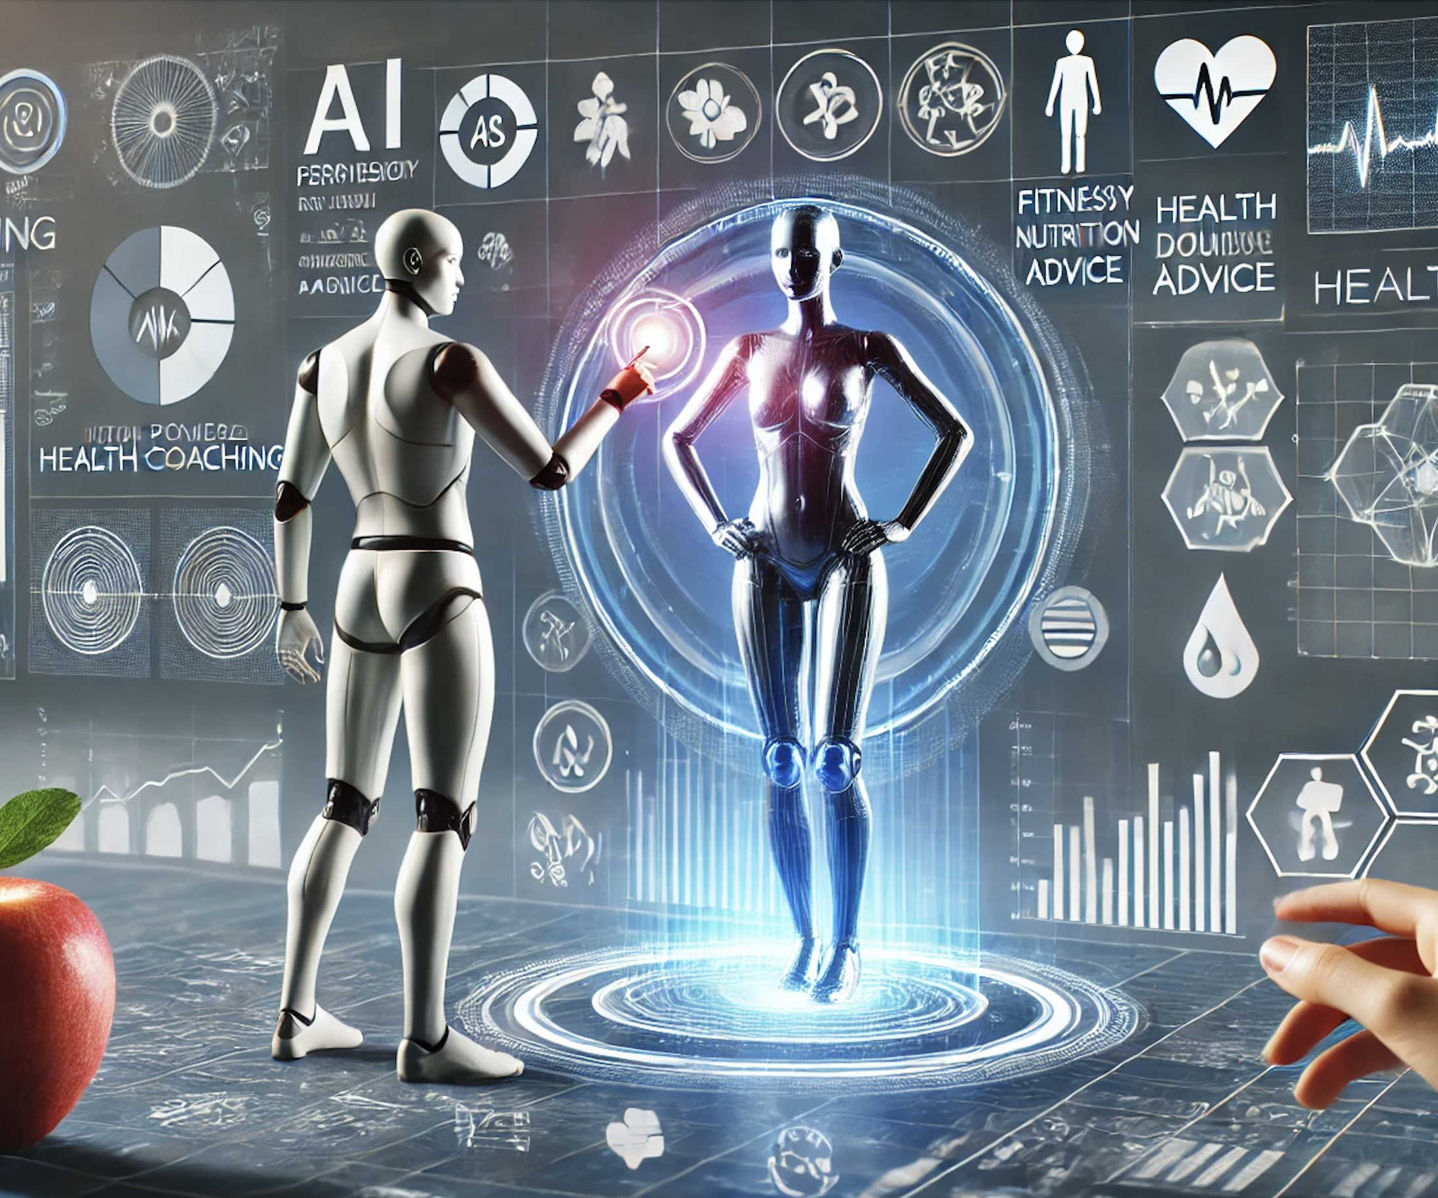
Real-Time AI powered Health coaching for diabetes
By
Ashna Ali
Sreevardhan Reddy Soma
Venkata Sai Veeramalla
Sai Kiran Basetty

Slide 2
Team Members and RoleS
Ashna Ali, Project Lead
Coordinated other team members and set deadlines for tasks
Literature review
Back-end, Preprocessing Data
Sai Kiran
Model training, UI framework
Venkata
Preprocessing Data and Analysis, model building
Researched on potential datasets
Sreevardhan
model training, UI framework (frontend)

Slide 3
Agenda
Introduction
Problem Statement
Proposed Work
Datasets
Existing Works
Conclusion
References
Novelty

Slide 4
Introduction
The incidence of diabetes, especially Type-2 diabetes, pre-diabetes, and gestational diabetes, is rapidly growing worldwide affecting millions of people.
Early identification of these conditions is crucial to preventing severe health complications which can be mitigated through timely intervention.
Despite advancements in healthcare technology, a significant number of individuals remain undiagnosed or are diagnosed too late, resulting in the progression of the disease and increased healthcare challenges.
The rising burden of diabetes is placing immense strain on healthcare systems worldwide, emphasizing the need for effective prevention and management strategies to address this growing crisis.

Slide 5

Problem Statement
A significant number of individuals with pre-diabetes, Type-2 diabetes, and gestational diabetes go undiagnosed, often until complications arise.
Delayed diagnosis can lead to severe complications, including cardiovascular disease, nerve damage, and kidney failure, increasing the burden on healthcare systems.
Existing diagnostic methods often fail to identify at-risk individuals early enough, especially in communities with limited access to healthcare.
There is a critical need for more accessible, accurate, and early detection methods to prevent the progression of diabetes and reduce healthcare costs.

Slide 6
Proposed work
Data Collection & Preprocessing
Model Training & Validation
Model Development
Application Development
Performance Evaluation

Slide 7
Proposed work
Data Collection & Preprocessing: Assemble and preprocess a diverse dataset, including demographic information, lifestyle factors, and biometric measurements (e.g., age, ethnicity, weight, glucose levels, gender).
Model Training & Validation: Train and validate the model using advanced machine learning techniques, aiming for high accuracy, sensitivity, and specificity.
Model Development: Create a machine learning model to predict the likelihood of pre-diabetes, type 2 diabetes, or gestational diabetes based on individual user data.
Application Development: Integrate the model into a user-friendly application, ensuring easy access for healthcare providers and individuals.
Performance Evaluation: Compare the model’s performance with existing diagnostic methods to assess its effectiveness and reliability.

Slide 8
Methodology
Model
Logistic Regression for interpretability (baseline)
Random Forest or XGBoost for a balanced approach between performance and interpretability
Deep Neural Networks if our data becomes too large to handle or if we decide to include image data (i.e. retinal scans)
Metrics for Comparison
Accuracy, sensitivity, specificity, F1-score, AUC-ROC, etc.

Slide 9
Datasets
Diabetes prediction dataset: This dataset includes medical and demographic data from patients, along with their diabetes status (positive or negative). Some of the key features are Age, Gender, Body Mass Index (BMI), Hypertension, Heart Disease, Smoking History, HbA1c Level and Blood Glucose Level. Link: https://www.kaggle.com/datasets/iammustafatz/diabetes-prediction-dataset
Diabetes dataset: The dataset is from the National Institute of Diabetes and Digestive and Kidney Diseases, focuses on predicting diabetes in Pima Indian females aged 21 and older. It includes various medical predictors like age, BMI, and blood glucose levels, with the outcome variable indicating whether a patient has diabetes. Link: https://www.kaggle.com/datasets/akshaydattatraykhare/diabetes-dataset
Diabetes Health Indicators Dataset: The BRFSS, a CDC health survey, has data from 2015 with 441,455 responses and 330 features. For this project, three datasets were used, focusing on diabetes. These datasets vary in balance and target variable classes, with feature variables derived from survey responses or calculated metrics. This dataset will be useful for health indicators to enhance the model such as physical activity and dietary habits. Link: https://www.kaggle.com/datasets/alexteboul/diabetes-health-indicators-dataset

Slide 10
Existing works
Machine Learning and Deep Learning Predictive Models for Type 2 Diabetes: A Systematic Review (Fregoso-Aparicio et al., 2021): Analyzed 90 studies; tree-based algorithms like Random Forests excel in accuracy and interpretability; highlights challenges in transparency and clinical applicability of Deep Neural Networks (DNNs).
Machine and deep learning techniques for the prediction of diabetics: a review (Kumar & Vijay Kumar Jha, 2024): Overview of ML/DL methodologies; focuses on challenges like class imbalance, model interpretability, and data privacy; discusses successes and limitations of models like SVM, Random Forest, CNN, and RNN.
Diabetes Prediction Using Ensembling of Different Machine Learning Classifiers (Hasan et al., 2020): Combines multiple classifiers (e.g., k-NN, Decision Trees, Random Forest) using a weighted ensemble; achieves high AUC (0.950) by addressing data quality and class imbalance issues.
Early Prediction of Gestational Diabetes Mellitus in the Chinese Population via Advanced Machine Learning” (Wu et al., 2021): Uses ML to predict GDM in early pregnancy; DNN model with full dataset achieves highest AUC (0.80); emphasizes the importance of thyroid function and lipid metabolism in GDM prediction.

Slide 11
novelty
Unified Prediction Model: Unlike previous research that focuses on specific diabetes types, our project integrates predictions for pre-diabetes, Type 2 diabetes, and gestational diabetes into a single model.
Real-Time Health Coaching: Our project uniquely combines prediction with personalized, real-time health coaching, offering actionable steps for prevention and management.
User Accessibility: The model emphasizes ease of use, ensuring widespread adoption by healthcare providers and individuals alike.
Holistic Approach: By utilizing a comprehensive dataset, our model provides a personalized approach to diabetes management, filling a critical gap in current AI applications.

Slide 12
conclusion
Our project predicts pre-diabetes, Type 2 diabetes, and gestational diabetes in one integrated model.
Offering personalized, real-time guidance to help users prevent and manage diabetes effectively.
Using detailed data on demographics, lifestyle, and health, our model provides a well-rounded approach to diabetes management.
This project fills important gaps in current AI tools for diabetes, improving both prediction and prevention.

Slide 13
references
Fregoso-Aparicio, L., Noguez, J., Montesinos, L., & García-García, J. A. (2021). Machine learning and deep learning predictive models for type 2 diabetes: a systematic review. Diabetology & Metabolic Syndrome, 13(1). https://doi.org/10.1186/s13098-021-00767-9
Kumar, S., & Vijay Kumar Jha. (2024). Machine and deep learning techniques for the prediction of diabetics: a review. Multimedia Tools and Applications. https://doi.org/10.1007/s11042-024-19766-9
Hasan, Md. K., Alam, Md. A., Das, D., Hossain, E., & Hasan, M. (2020). Diabetes Prediction Using Ensembling of Different Machine Learning Classifiers. IEEE Access, 8, 76516–76531. https://doi.org/10.1109/access.2020.2989857
Wu, Y.-T., Zhang, C., Ben W.J. Mol, Kawai, A., Li, C., Chen, L., Wang, Y., Sheng, J.-Z., Fan, J., Shi, Y., & Huang, H.-F. (2021). Early Prediction of Gestational Diabetes Mellitus in the Chinese Population via Advanced Machine Learning. The Journal of Clinical Endocrinology and Metabolism, 106(3), e1191–e1205. https://doi.org/10.1210/clinem/dgaa899

